Slide 1
Presented by: Nikita Patil
Game Delivery Dashboard

Slide 2
Objective
To analyze sales, profit, and delivery performance of game products across different time periods and regions using an interactive dashboard.

Slide 3
Dataset Overview
Source: Game Delivery Excel Dataset
Fields Used: Purchase Date, Ship Date, Region, Country, Grouping, Sub-Grouping, Sales, Profit, Quantity, Ship Status
Records: Over 2,000 rows
Tools Used: Tableau, Excel

Slide 4
Key Metrics & KPIs
Total Deliveries
Average Delivery Time
Deliveries by Region
Platform-wise Distribution
Trend of Deliveries Over Time

Slide 5
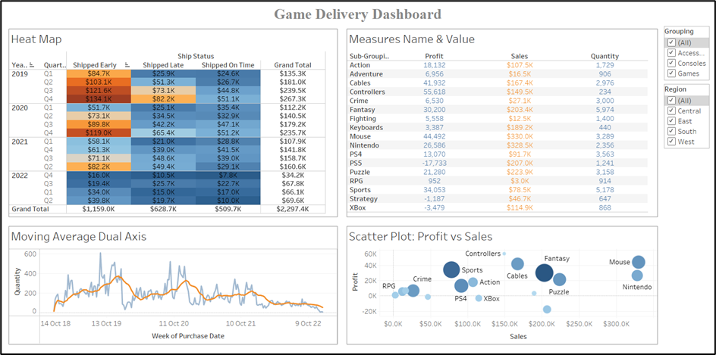
Dashboard Snapshot

Slide 6
Key Insights
Highest profit and sales observed in Nintendo and Fantasy categories
2021 Q2 had the highest early shipments
Quantity peaked in 2019-2020 and then trended downward
West region saw the largest share of shipments and sales
XBox and Controllers contributed significantly to total revenue

Slide 7
Thank you

